Slide 1

Sense of Belonging

Slide 2
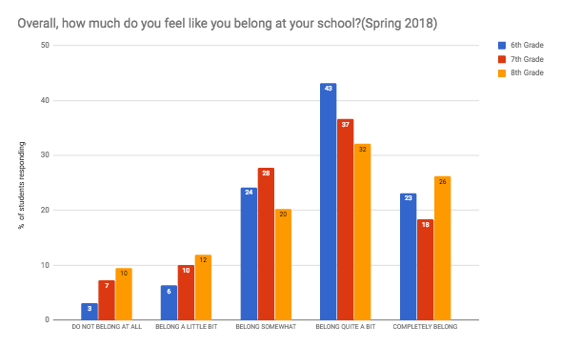
What do you notice?
©2018 Catalina Foothills School District, Tucson, AZ

Slide 3
What do these trends suggest?
©2018 Catalina Foothills School District, Tucson, AZ

Slide 4
What do these trends suggest?
©2018 Catalina Foothills School District, Tucson, AZ

Slide 5
What is the general trend of sense of belonging over time?
Is it going up?
Is it going down?
Is it oscillating?
Is it staying about the same?
Sense of Belonging
Time
*What kind of graph do we want?

Slide 6
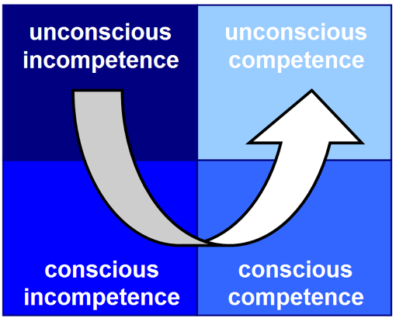
Stages of Knowing - Where are you with stock-flow maps?
Don’t know it, can’t do it, don’t see the value
Second nature, may be able to teach it to others
Sort of know it, can’t do it, want to be able to
Know it, can do it, but it takes a concentrated effort
Graphic from www.huffingtonpost.com

Slide 7

“Essentially, all models are wrong, but some are useful.”
-George E.P. Box

Slide 8

Step 1: Identify the stock(s)
What are the most important accumulations in the system?
Pick one or two to start with (Sense of Belonging).
Graphic from pbslearningmedia.org

Slide 9
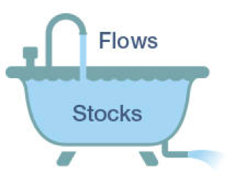
Step 2: Identify the flows
•Is there an inflow? Does the stock ever go up?
•Is there an outflow? Does the stock ever go down?
•Keep labels simple (increasing and decreasing).

Slide 10
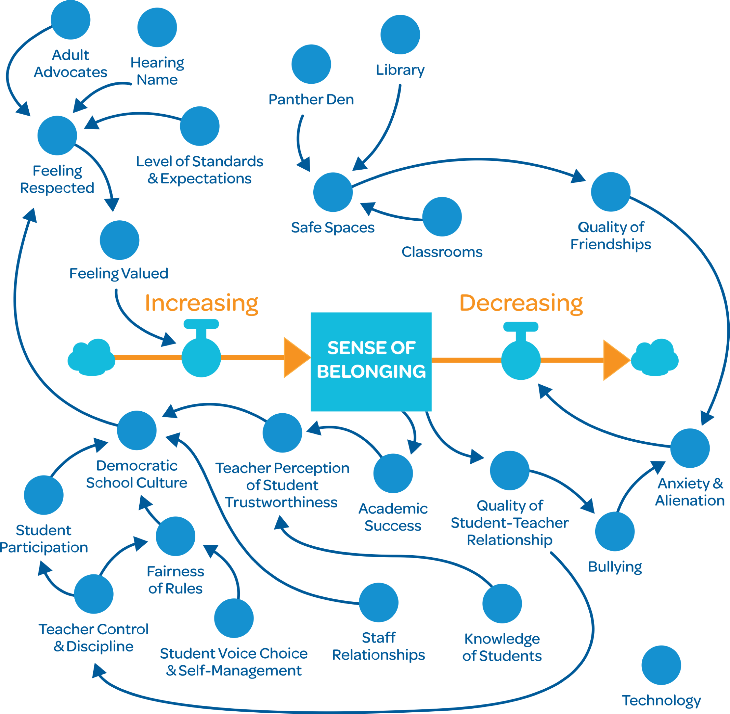
Step 3: What converters should be added?
•What causes the stock to increase?
•What causes it to decrease?
•Do the converters directly cause this to happen, or do they go through other converters?
•Label converters thoughtfully.

Slide 11
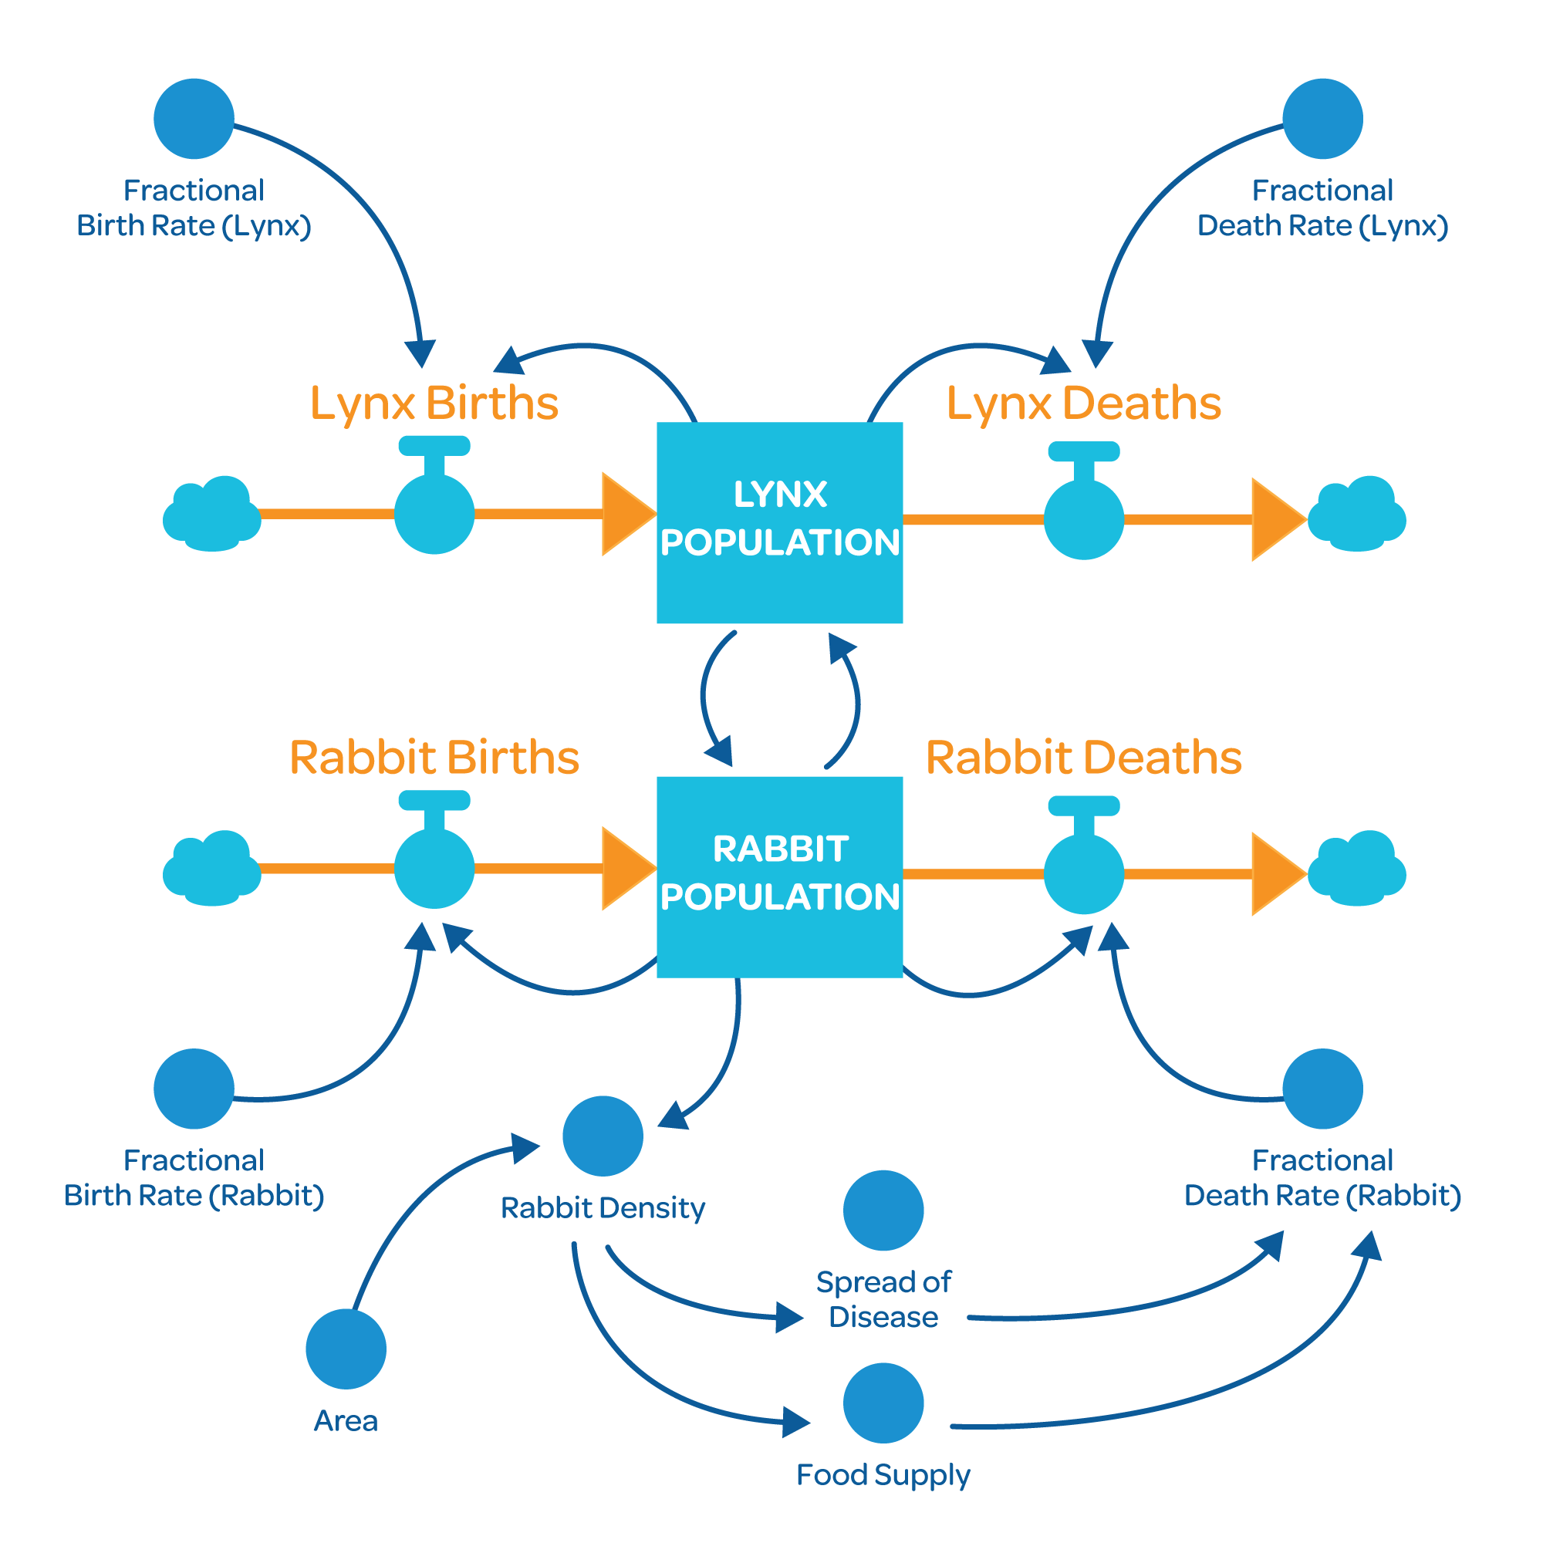
Step 4: Is there feedback in the system? How does it work?
Where are the loops?
Does a stock affect itself?
Does it go directly to a flow or does it go through a converter?

Slide 12
Step 5: Revise, edit, clean up
•Do all labels make sense?
•Do all the connections make sense?
•Are there any redundancies (multiple connectors doing the same thing)?
•Try to avoid crossing over – “plate of spaghetti.”

Slide 13
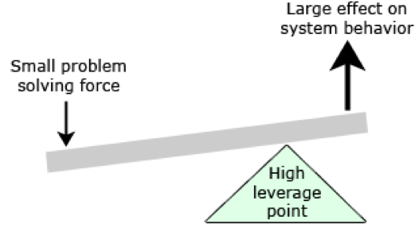
Step 6: Where is the leverage?

Slide 14
Discuss: Which of the DLPs did this approach address?
Systems Thinking?
Critical Thinking?
Problem Solving?
Collaboration?
Communication?
Citizenship?

Slide 15
Sense of Belonging
P.D. Session #2

Slide 16
Task #1: Revisit/Review/Revise (15 minutes)
Take a look at the stock-flow map you created at the retreat. After experiencing the first week of school and some distance:
What would you change?
What would you add?
What would you take out?
What would you reorganize?
What would you rename?
Key question: Would someone else understand what you’re thinking?

Slide 17
Task #2: Create an analogy (20 minutes)
Pull together key elements of our school improvement plan – include as many of the following elements as possible:
Sense of belonging
Curiosity
Compassion
Problem solving
Capability
Panther Pride
Any others you think fit and make sense
Possible analogies: House, automobile, tree, human body, book, bicycle

Slide 18
Task #3: Share your analogy (20 minutes)
Each group shares/explains their analogy
Two-minute time limit

